Slide 1
Introduction to Statistics for Ecology and Evolutionary Biology Bayesian Basics Week 06 October 18, 2020

Slide 2
Thought experiment
“A patient goes to see a doctor. The doctor performs a test with 99 percent reliability--that is, 99 percent of people who are sick test positive and 99 percent of the healthy people test negative. The doctor knows that only 1 percent of the people in the country are sick. Now the question is: if the patient tests positive, what are the chances the patient is sick?”
https://www.scientificamerican.com/article/what-is-bayess-theorem-an/

Slide 3
Thought experiment
Let’s assume a population of 10,000 people, and a prevalence of 1%
We want to know the probability of having the disease given that the test is +
Test outcome | Has the disease | Does not have disease | Total
Test result is +
Test result is -
Total | 100 |  | 10,000

Slide 4
Thought experiment
Let’s assume a population of 10,000 people, and a prevalence of 1%
We want to know the probability of having the disease given that the test is +
Test outcome | Has the disease | Does not have disease | Total
Test result is + | 99
Test result is - | 1
Total | 100 |  | 10,000

Slide 5
Thought experiment
Let’s assume a population of 10,000 people, and a prevalence of 1%
We want to know the probability of having the disease given that the test is +
Test outcome | Has the disease | Does not have disease | Total
Test result is + | 99 | 99
Test result is - | 1 | 9,801
Total | 100 | 9,900 | 10,000

Slide 6
Thought experiment
Let’s assume a population of 10,000 people, and a prevalence of 1%
We want to know the probability of having the disease given that the test is +
Test outcome | Has the disease | Does not have disease | Total
Test result is + | 99 | 99 | 198
Test result is - | 1 | 9,801 | 9,802
Total | 100 | 9,900 | 10,000
Notes:
This kind of logic / calculation is applying Bayes theorem, which we will formalize in a bit, and is rather intuitive. It uses existing information, in this case the population prevalence of the disease and the accuracy of the test, to obtain the answer.

Slide 7
Tree diagram
Population
Disease
p = 0.01
No disease
p = 0.99
Test +
p = 0.99
Test –
p = 0.01
Test +
p = 0.01
Test –
p = 0.99
0.01 * 0.99 = 0.099
0.01 * 0.01 = 0.0001
0.99 * 0.01 = 0.099
0.99 * 0.99 = 0.9801

Slide 8
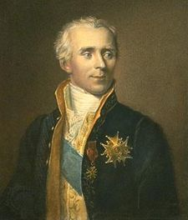
Thomas Bayes
Pierre-Simon Laplace
English statistician and Presbyterian minister (1701-1761)
French scholar and mathematician (1749-1827)

Slide 9
Notes:
The Theory That Would Not Die by Sharon McGrayne

Slide 10
Summary of Bayesian Inference
We make formal conjectures about the state of the world
(assign prior probability distributions to parameters)
and modify this information in the light of evidence
(data)
to produce updated inference
(posterior probability distributions)
Notes:
This process of Bayesian learning is also called Bayesian updating

Slide 11
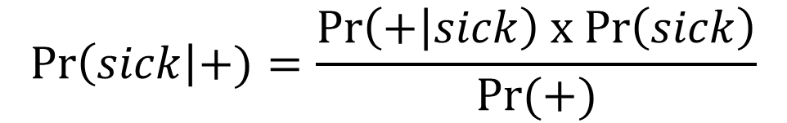
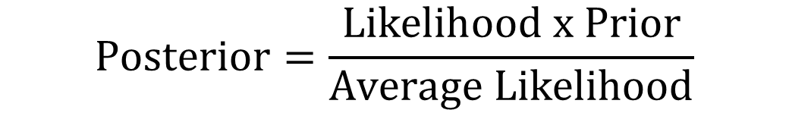
Bayes’ Theorem
$$\operatorname{Pr}\left(sick\right|+)=\frac{Pr\left(+ | sick\right) x Pr\left(sick\right)}{Pr(+)}$$
$$\operatorname{Posterior}{=\frac{Likelihood x Prior}{Average Likelihood}}$$
$$\operatorname{Posterior}{∝}Likelihood x Prior$$
Notes:
“The key lesson is that the posterior is proportional to the product of the prior and the likelihood.”

Slide 12
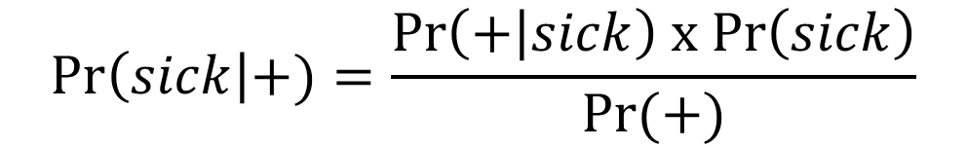
Bayes’ Theorem
Conditional probability of a + test, given the patient is sick (likelihood)
Conditional probability of being sick, given + test
$$\operatorname{Pr}\left(sick\right|+)=\frac{Pr\left(+ | sick\right) x Pr\left(sick\right)}{Pr(+)}$$
Marginal probability of being sick
Marginal probability of a positive test (prior probability)
$$\operatorname{Posterior}{∝}Likelihood x Prior$$
Notes:
“The key lesson is that the posterior is proportional to the product of the prior and the likelihood.”

Slide 13
Thought experiment
Let’s assume a population of 10,000 people, and a prevalence of 1%
We want to know the probability of having the disease given that the test is +
Test outcome | Has the disease | Does not have disease | Total
Test result is + | 99 | 99 | 198
Test result is - | 1 | 9,801 | 9,802
Total | 100 | 9,900 | 10,000
Notes:
This kind of logic / calculation is applying Bayes theorem, which we will formalize in a bit, and is rather intuitive. It uses existing information, in this case the population prevalence of the disease and the accuracy of the test, to obtain the answer.

Slide 14
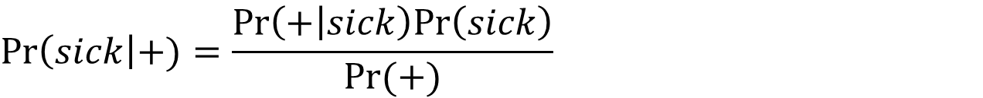
Using Bayes’ theorem
$$\operatorname{Pr}\left(sick\right|+)=\frac{Pr\left(+ | sick\right)Pr\left(sick\right)}{Pr(+)}$$
$$\operatorname{Pr}\left(sick\right|+)=\frac{Pr\left(+ | sick\right)Pr\left(sick\right)}{Pr\left(+ | sick\right)Pr\left(sick\right)+Pr\left(+ | not sick\right)Pr(not sick)}$$
$$\operatorname{Pr}\left(sick\right|+)=\frac{0.99 x 0.01}{0.99 x 0.01+0.01 x 0.99}$$
$$\operatorname{Pr}\left(sick\right|+)=0.5$$

Slide 15
Formalizing Bayesian Inference
Likelihood – mathematical formula that specifies the plausibility of the data
Parameters – quantities we wish to estimate from the data
Prior – initial set of plausible values for a parameter
Priors with no information: “flat”, “naïve”, or “un-informative”
Priors with some information: “regularizing” or “weakly informative”
Notes:
Show dbinom() function in R script to emphasize the fact that the likelihood function is showing us the relative plausibility of different outcomes

Slide 16
There is always prior information
Notes:
Parameters are characteristics of a statistical population or a statistical model we wish to estimate
For instance, the mean mass of adult male housecats and the mean mass of adult male lions are two parameters we might be interested in estimating
What do we know about these two parameter a priori? In other words, what might we know about these parameters before seeing any data?
https://c.pxhere.com/photos/e6/e1/cat_laying_pet_animal_domestic_animal_feline_cute_mammal-1125748.jpg!d
https://upload.wikimedia.org/wikipedia/commons/thumb/7/73/Lion_waiting_in_Namibia.jpg/1200px-Lion_waiting_in_Namibia.jpg

Slide 17
Formalizing Bayesian Inference
Once a likelihood, parameter(s), and prior(s) have been specified, you expose them to data to generate inference
The resulting inference is represented by the posterior
Posterior distribution – the relative plausibility of different parameter values, given your prior and the data observed

Slide 18
Illustrating the process of Bayesian updating of prior information
Example: Estimate the true proportion of water on the glob through a series of globe tosses, measuring whether our finger lands on water (W) or land (L)
Notes:
Explain globe-tossing data example from the text
The parameter of interest is the proportion of the globe that is covered in water
The data we collect is whether land or water is recorded underneath our finger with each globe toss
https://www.waypointgeographic.com/p/little-adventurer-globe/?gclid=EAIaIQobChMIqe3Gw_LW5wIVFJSzCh28DgpQEAQYASABEgJQFvD_BwE

Slide 19
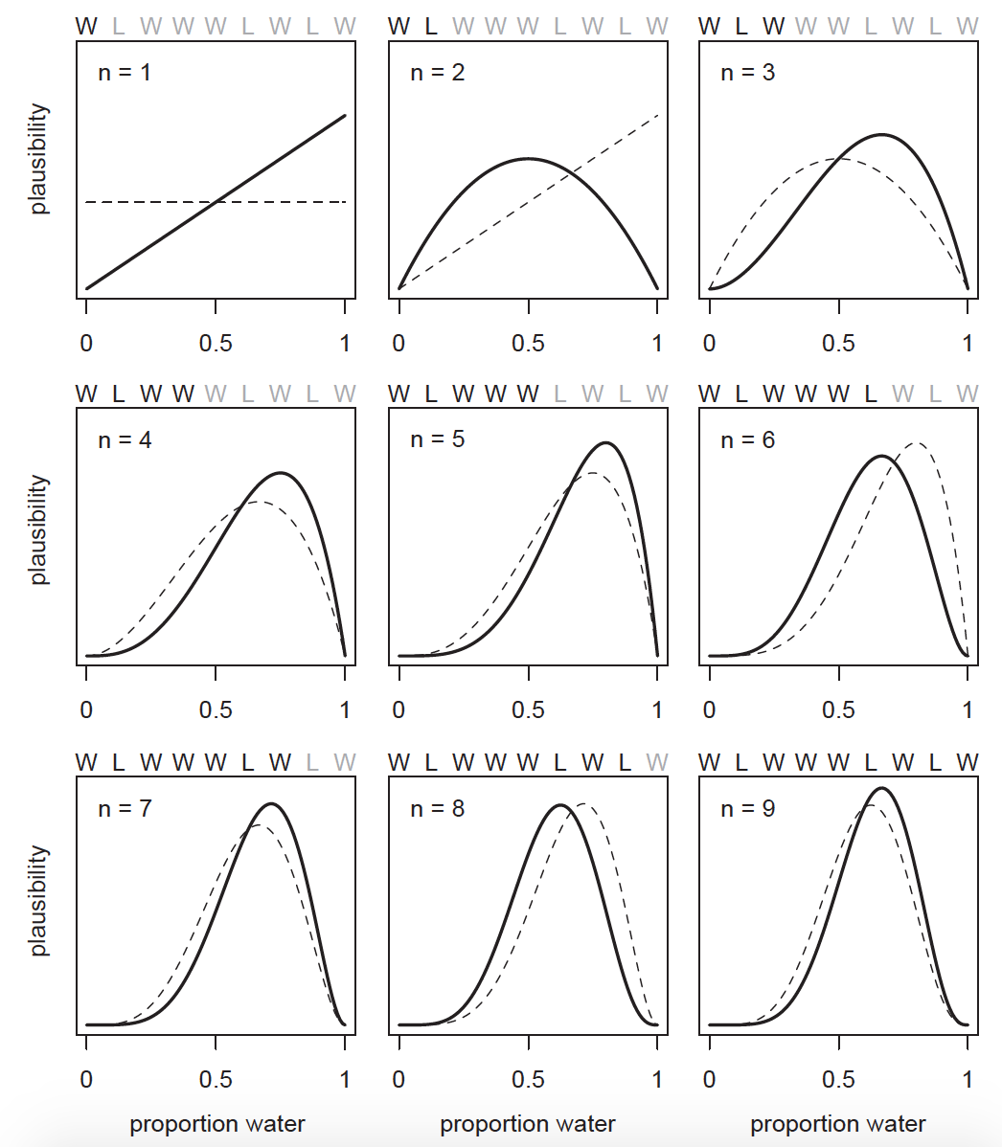
If we get water on the first throw, and that is the only information we have, this data is consistent with the entire globe being covered in water, and p = 1 is the most plausible estimate given our data.
Proportion of water on globe

Slide 20
If we get land on the second throw, our estimate is revised to p = 0.5, because half of our data indicate water, the other indicate land. Other values are less likely given the data.
Proportion of water on globe

Slide 21
Proportion of water on globe

Slide 22
Proportion of water on globe
Notes:
Key points:
Updating plausibility in the light of evidence from the data. Observed Ws move the curve to the right, observed Ls move it to the left.
However, parameter values quite far from the “true” value can remain plausible
Maximum relative plausibility increases with data
Highlights the importance of sample size

Slide 23
Note on sample size
Maximum relative plausibility increases with sample size
However, Bayesian estimates are valid for any sample size, in contrast to non-Bayesian statistics, where validity of estimates often rests on the assumption of asymptomatic behavior at large sample sizes (e.g., 30+ for estimator for a normal distribution)
BUT: Bad prior can invalidate results at small sample sizes. There is NO FREE LUNCH!

Slide 24
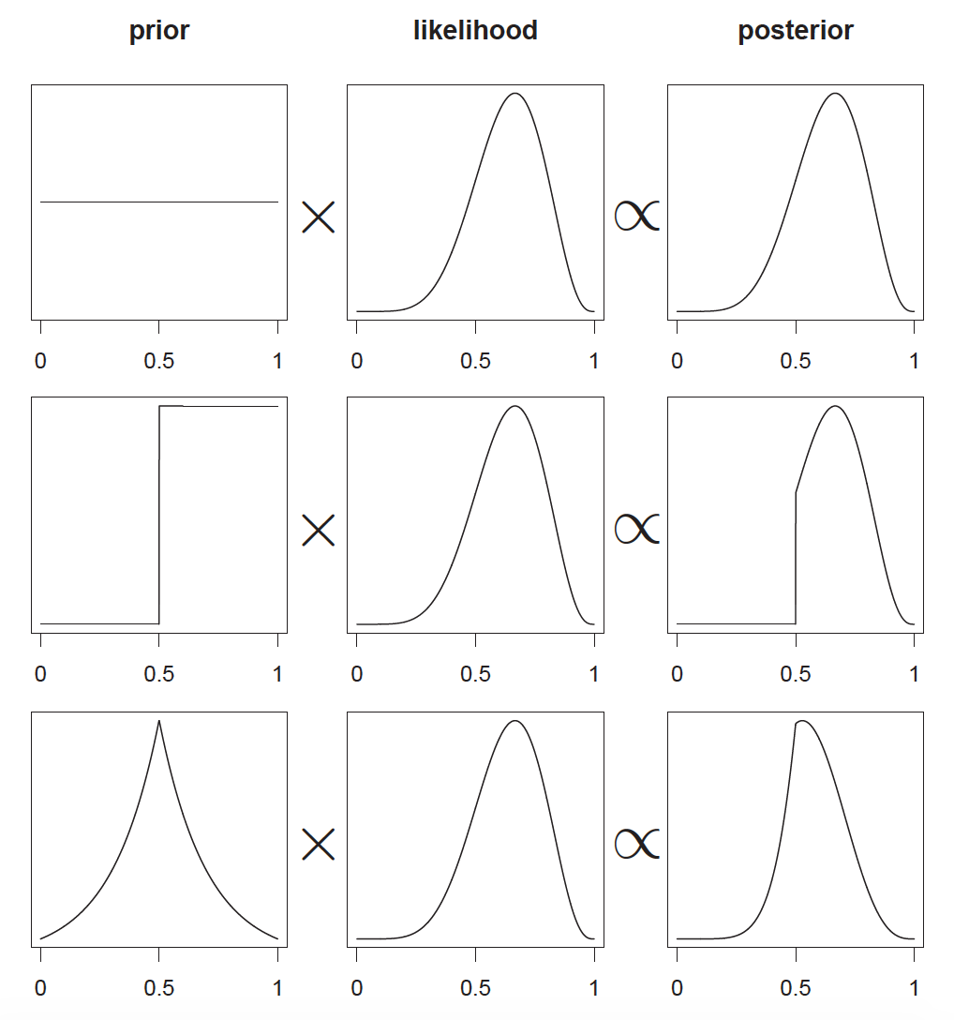
The posterior distribution is the result of a multiplicative interaction between the prior distribution and the likelihood
The same likelihood distribution, say from a binomial distribution function, can result in different posterior estimates depending on what priors we select.
Notes:
These graphics highlight that the posterior is the result of a multiplicative interaction between the prior and the likelihood

Slide 25
Important Caveat
Posterior distributions reflect model’s certainty about a parameter given the assumptions built into the model
No guarantee the model is a good one
All models are wrong, but some are useful
Choice of likelihood functions is crucial for proper inferences

Slide 26
Numerical Methods for Bayesian Inference
1) Grid approximation
This week, using standard R functionality
2) Quadratic approximation
Most of the rest of the semester using rethinking package functions
3) Markov chain Monte Carlo (MCMC)
End of the semester using rethinking package functions that call Stan
Notes:
Go to lecture code script to show the process of grid approximation for posterior estimation

